Slide 1
Universal Serial Bus (USB)
CSE 315
Peripheral and Interfacing
Md Mahedi Hassan
Lecturer, Dept. of CSE, UAP

Slide 2
Introduction
A plug and play interface that allows a computer to communicate with peripheral and other devices
A fast, bidirectional, isochronous, low-cost, dynamically attachable/detachable serial interface for connecting peripherals.

Slide 3
Features
Simplifies connection process and enables addition of peripherals
Establishes communication over a 4-wire cable
Supported data transfer rates
480Mb/s
12Mb/s
1.5Mb/s
Many peripherals over one port
Up to 127 peripherals can be connected to a OC

Slide 4
Features (Cont…)
Bandwidth share using token-based protocol
Conforms plug and play
Distributes electrical power automatically
Allows two-way data flow
Replaces serial and parallel port
Windows 98 and Windows NT have USB support

Slide 5
USB System
USB Host refers to a PC
Only one USB Host allowed in the system
USB Device refers to Peripheral Devices
USB Host
USB Cable
USB Device

Slide 6
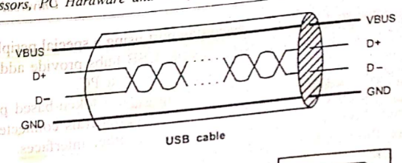
USB Cable
Four wires
D+ and D- data lines carry signals between host and device
V_{BUS} and GND delivers power
Allows supply voltage to be between 5.25V and 4.2V

Slide 7
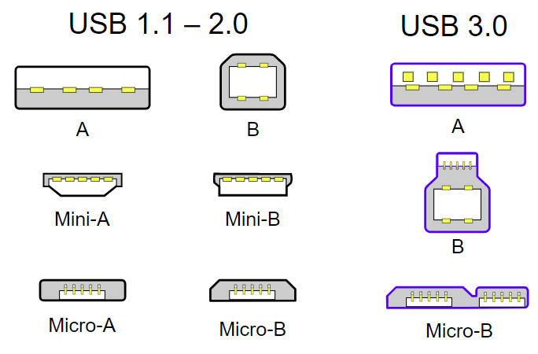
USB Connector
Two types of connectors
Type A (for PC)
Type B (for peripherals)

Slide 8
Implementation of USB Interface
Client Software
Function
USB System Software
USB Logical Device
USB Host Controller
USB Interconnect
USB Bus Interface
HOST
DEVICE

Slide 9
USB Host
Detects attachment and removal of USB devices
Manages flow of control information
Manages flow of data
Collects activity and status information of USB devices
Provides power to low power devices

Slide 10
USB Device
Monitors device address in each communication and selects itself
Responds to all requests made by host
Adds error checking bits and checks for errors
Manages its own power supply

Slide 11
USB Device (Cont…)
Real world I/O
Custom I/O device
Protocol controller Application firmware
byte
control
Bus interface H/W
Serial Inference Engine
Transceiver
D+
D-

Slide 12
USB Device (Cont…)
Serial Inference Engine (SIE) has a buffer of definite size known as end points
It stores configuration and data information
Host delivers data into OUT end point
Device places data into IN end point
A device has up to 16 IN and 16 OUT end points
Transceiver takes care of the electrical requirements
SIE takes care of the bit timing
USB device controller (a microprocessor/microcontroller/digital signal processor) executes a program to respond to various requests

Slide 13
Transfer Types
Four basic types of data transfer between the host and the devices
Control transfer
Bulk data transfer
Interrupt data transfer
Isochronous data transfer

Slide 14
Control Transfer
Configures a device at attach time
High priority
Automatic error protection
High data rate

Slide 15
Bulk Data Transfer
Used to transfer bulk amount of data to a printer or from a scanner
Time is not a critical parameter
Implements error detection in hardware
Sequential data transfer

Slide 16
Interrupt Data Transfer
Timely but reliable data transfer
Interrupt data are
Event notifications
Characters
Coordinates
Keyboards and mouse use this method

Slide 17
Isochronous Data Transfer
Streams real time data transfer
Devices transferring huge amount of data at definite rate use this method (Example: sound cards)
Does not implement error detection

Slide 18
THANK YOU

